Slide 1
Monitoring with Prometheus and Grafana
Assuring business value
Lucas Jellema, CTO of AMIS
Fall 2018
Notes:
Fast data arrives in real time and potentially high volume. Rapid processing, filtering and aggregation is required to ensure timely reaction and actual information in user interfaces. Doing so is a challenge, make this happen in a scalable and reliable fashion is even more interesting. This session introduces Apache Kafka as the scalable event bus that takes care of the events as they flow in and Kafka Streams and KSQL for the streaming analytics. Both Java and Node applications are demonstrated that interact with Kafka and leverage Server Sent Events and WebSocket channels to update the Web UI in real time. User activity performed by the audience in the Web UI is processed by the Kafka powered back end and results in live updates on all clients.
Fast data arrives in real time and potentially high volume. Rapid processing, filtering and aggregation is required to ensure timely reaction and actual information in user interfaces. Doing so is a challenge, make this happen in a scalable and reliable fashion is even more interesting. This session introduces Apache Kafka as the scalable event bus that takes care of the events as they flow in and Kafka Streams for the streaming analytics. Both Java and Node applications are demonstrated that interact with Kafka and leverage Server Sent Events and WebSocket channels to update the Web UI in real time. User activity performed by the audience in the Web UI is processed by the Kafka powered back end and results in live updates on all clients. Introducing the challenge: fast data, scalable and decoupled event handling, streaming analytics Introduction of Kafka demo of Producing to and consuming from Kafka in Java and Nodejs clients Intro Kafka Stream API for streaming analytics Demo streaming analytics from java client Intro of web ui: HTML 5, WebSocket channel and SSE listener Demo of Push from server to Web UI - in general End to end flow: - IFTTT picks up Tweets and pushed them to an API that hands them to Kafka Topic. - The Java application Consumes these events, performs Streaming Analytics (grouped by hashtag and author and time window) and counts them; the aggregation results are produced to Kafka - The NodeJS application consumes these aggregation results and pushes them to Web UI - The WebUI displays the selected Tweets along with the aggregation results - in the Web UI, users can LIKE and RATE the tweets; each like or rating is sent to the server and produced to Kafka; these events are processed too through Stream Analytics and result in updated Like counts and Average Rating results; these are then pushed to all clients; this means that the audience can Tweet, see the tweet appear in the web ui on their own device, rate & like and see the ratings and like count update in real time

Slide 2

Lucas Jellema Architect / Developer 1994 started in IT at Oracle 2002 joined AMIS Currently CTO & Solution Architect

Slide 3
Overview

Slide 4
Monitoring
Ensure non-functional behavior of business functions/applications
Availability and health
Performance
Access – as it should be for whom it should be

Slide 5
What is required for monitoring?
Gather metrics
And prepare | wrangle metrics (tag, filter, enrich, aggregate, …)
To raise alert
To human (via ticket/SMS/…)
To automated handler/agent
To support issue resolution (data for root cause analysis)
To analyze trends + effects/impact of change

Slide 6
Type of metrics
Primary metrics
Tied to SLA indicators
Relevant – representative of Key Business Indicators
End user experience
Business activity throughput
Cost efficiency
Secondary metrics
Predictors for primary metrics

Slide 7
Dashboard
Provide starting point to respond to an alert – start investigation (drill down, query)
Demonstration purposes
Always looks nice – a dashboard

Slide 8
Metrics are collected across the stack
Business Applications
SaaS, Standard Applications
Custom | Tailor made applications
Platform
Web Server, Application Server
Database
LDAP
JVM/Node/.NET/… runtime
Infra
Container, Container Platform (e.g. Kubernetes)
Operating System
Cache
Proxy, Load Balancer
Network
Storage, File System
metrics

Slide 9
Prometheus
Gather metrics into database
Scheduled pull |harvest| scrape actions – HTTP/TCP requests
Accessing Exporters and built in (scrape) endpoints
Make metrics availabe to consuming systems and humans
Such as Grafana (for dashboarding)
REST APIs
Prometheus UI – Graphs, Console, PromQL
Analyze metrics according to [alert] rules
Determine if alerts are “firing”
Act on firing alerts
Send notifications

Slide 10
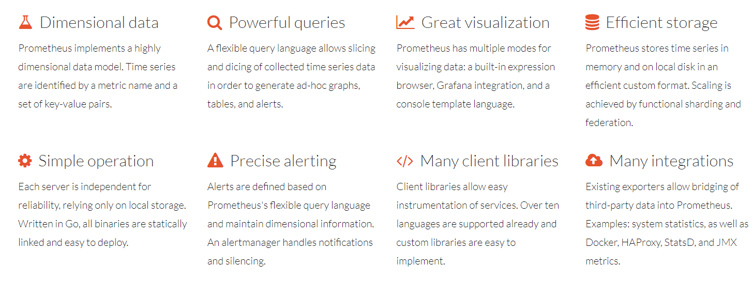
History and Status of Prometheus
Written in Go Lang – all open source, available on GitHub
Part of CNCF
https://prometheus.io/
Since when?
Defacto standard for gathering metrics
treating time-series data as a data source for generating alerts is now accessible to everyone through those open source tools like Prometheus

Slide 11
Prometheus Metrics
All are numeric
Uniquely identified by name and set of labels
All can be labeled (associated with dimensions)
Aggregation is done grouped by dimension
(labels should have limited number of values)
Filtering and Drill down is also done using labels
Two types of metrics are scraped:
Gauge – current value (%disk free, response time, state of database)
Counter - #occurrences – and the derived rate - #occurrences/time unit - (number of requests, number of bytes transferred);
counters can be reset but not decremented
Also:
Summary – reports quantiles as well as total sum and total count (over sliding window)
Histogram – maps observations to buckets and reports number of instances per bucket (over sliding window)

Slide 12





धन्यवाद dhanyavaad Thank you Dank je wel
Blog: technology.amis.nl
Email: lucas.jellema@amis.nl
: @lucasjellema
: lucas-jellema
: www.amis.nl, info@amis.nl
https://github.com/lucasjellema
Notes:
Ukranian: Dyakuyu - https://www.google.nl/search?q=thank+you+in+ukrainian&rlz=1C1GGRV_enNL762NL762&oq=thank+y&aqs=chrome.1.69i59l2j69i61j0j69i57j0.1774j0j9&sourceid=chrome&ie=UTF-8
Russian: Spasibo

